Slide 1

NORMA Lab. 1
Installing Visual Studio
Installing NORMA
Entering a simple ORM schema
Generating a Relational View
Generating DDL code
Generating other code
Note: Some of these slides have additional comments.
File: NORMA_Lab1.pptx. Author: T. Halpin. Last updated: 2016 August 31

Slide 2
Installing Visual Studio
Natural ORM Architect (NORMA) supports ORM 2 (Object-Role Modeling, version 2).
Currently, NORMA requires prior installation of Microsoft Visual Studio
(2005 or later).
The Community Edition of Visual Studio 2015 is freely available for most users, and may be downloaded from
http://www.visualstudio.com/products/visual-studio-community-vs
The above edition of Visual Studio is used for these NORMA Labs.
If you have not already done so, please install Visual Studio.

Slide 3
Installing NORMA
Public builds of NORMA are available as a free plug-in to Visual Studio.
Download the zip file for the latest public build of NORMA for your installed version of Visual Studio (VS2005, VS2008, VS2010, VS2012, VS2013, VS2015, …). For VS2017 currently the only NORMA that works is accessible at
http://www.ormfoundation.org/files/folders/norma_the_software/entry4065.aspx.
For earlier versions of VisualStudio, access either of the following:
http://www.ormfoundation.org/files/folders/norma_the_software/default.aspx
or http://sourceforge.net/projects/orm .
Unzip the downloaded file
(e.g. right-click the file, and choose Extract All …).

Slide 4
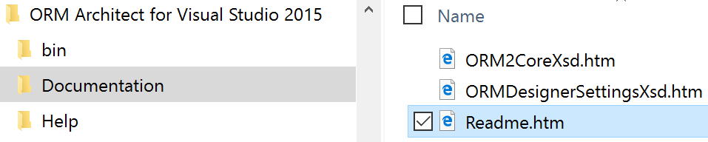
Install NORMA (including PLiX¹) as follows.
Open the unzipped folder.
Double-click the Readme.htm file in the extracted folder
(e.g. Windows (C:) > Program Files (x86) > ORM Solutions >
ORM Architect for Visual Studio 2015 > Documentation)
to view the Readme file in your Web browser.
This includes lots of useful tips as well as more detailed instructions.
¹ PLiX (Programming Language in XML) is used internally to
facilitate code generation to multiple target languages.

Slide 5
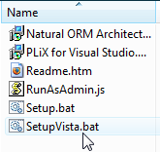
If using Microsoft Vista or later
(e.g. Windows 7, Windows 8, Windows 10)
double-click SetupVista.bat
and allow overrides of all the security blocks
(alternatively, right-click Setup.bat,
and Run as Administrator).
If using Microsoft XP, double-click Setup.bat.
Follow all the defaults in the installation wizard.
Note: If you previously had an earlier version of NORMA installed,
this will be automatically uninstalled before the new installation.
All of your previous ORM models will be retained.

Slide 6
Entering a simple ORM schema
Reference schemes: Patient(.Nr); PatientName(); Drug(.Name)
Fact types: Patient has PatientName.
Patient smokes.
Patient is allergic to Drug [allergy].
Constraints:
Each Patient has exactly one PatientName.
It is possible that the same Patient is allergic to more than one Drug
and that more than one Patient is allergic to the same Drug.
Notes:
Consider the sample forms about medical patients. Conceptually, each form involves 3 elementary fact types, as shown. Each patient has exactly one (at least one and at most one) patient name. A check box is used to indicate whether a patient smokes. A person may have zero or more drug allergies, and vice versa – this many-to-many nature of the relationship may be verbalized as shown. The ORM conceptual schema is specified in textual form.

Slide 7
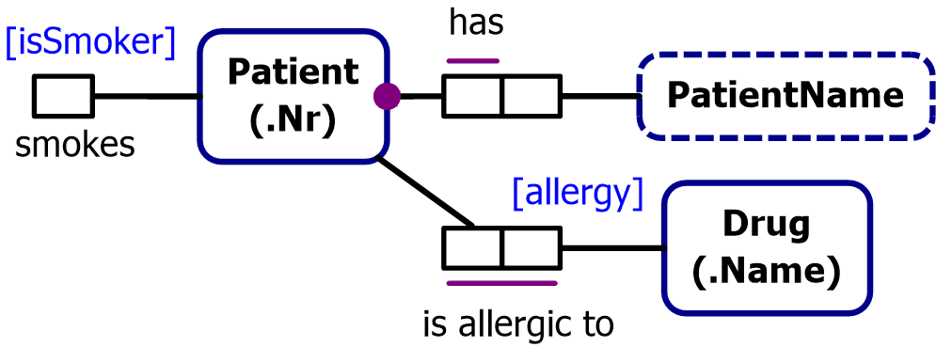
This is the basic ORM schema.
We will now enter it into NORMA
and then generate a database schema from it.
We will begin by creating the ORM file,
and later adding it a project (needed to generate DDL code).
Alternatively, you may create a project to begin with.

Slide 8
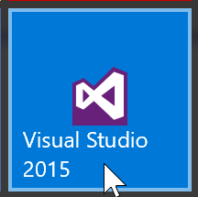
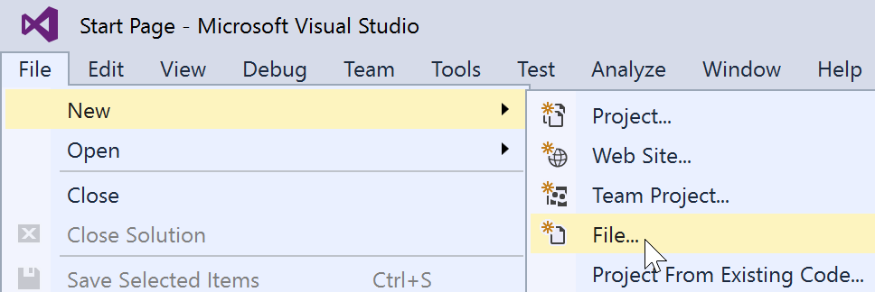
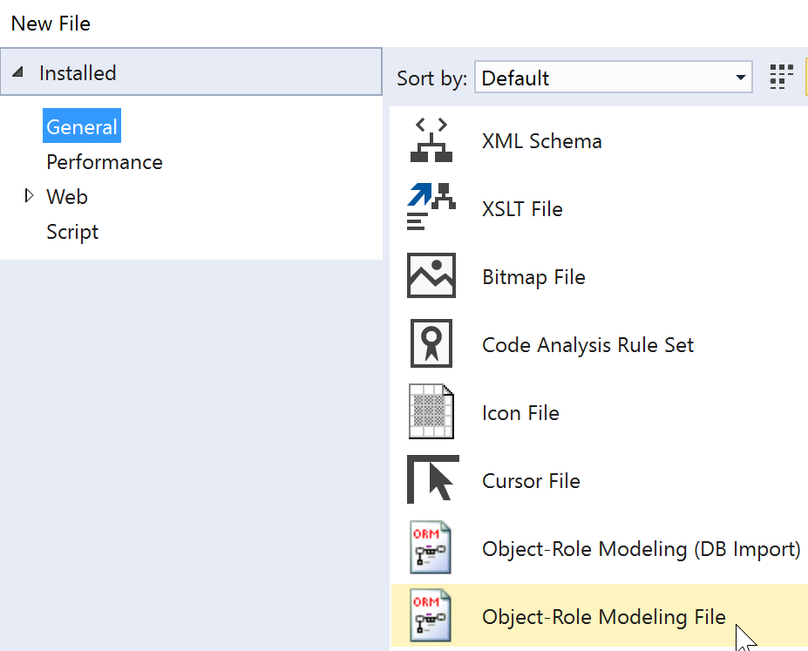

Launch Visual Studio.
Select File > New > File
Select General category,
then
Object-Role Modeling File
template.
Then click Open.

Slide 9
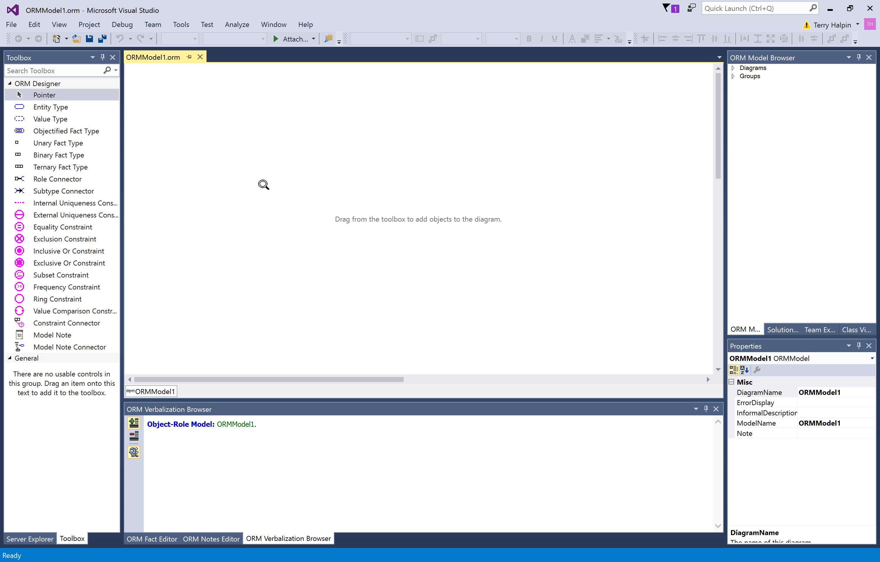
This is the Document Window
for displaying the ORM diagram.

Slide 10
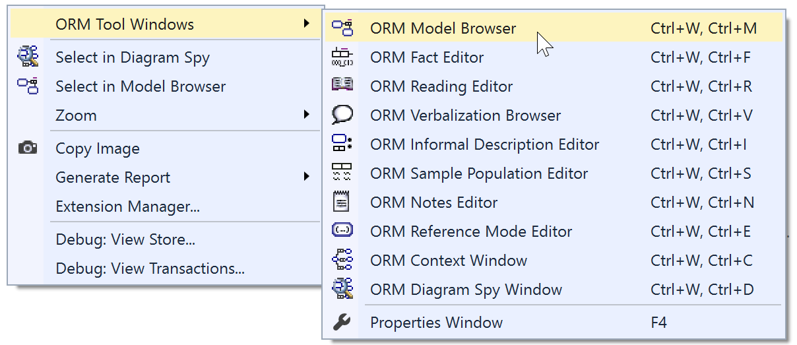
To see all available windows, right-click an
empty space in the document window.
This context menu appears.
If the Model Browser and Properties Window
don’t appear, select them here to display them.

Slide 11
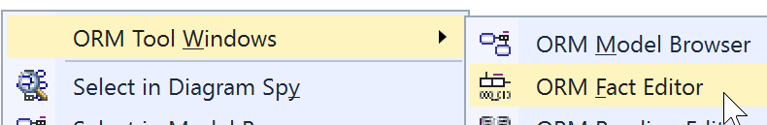
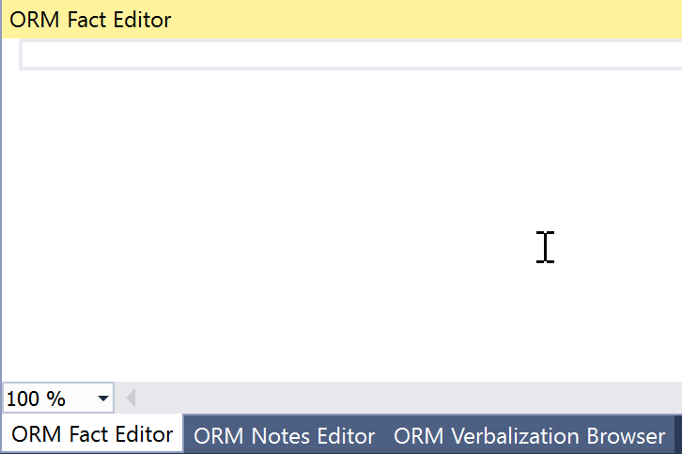
To open the Fact Editor window,
move the cursor to this option
then left-click the mouse.
The Fact Editor window should now be displayed.

Slide 12
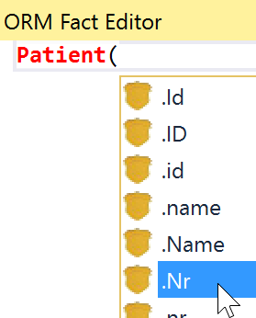



Enter the fact type
Patient(.Nr) has PatientName()
into the Fact Editor as follows:
Type “Patient(”
Click .Nr from the drop-down list
Type the closing parenthesis “)”
Type “ has PatientName()”
(5) Press Ctrl-Enter
The fact type should now be
displayed in the document window.

Slide 13
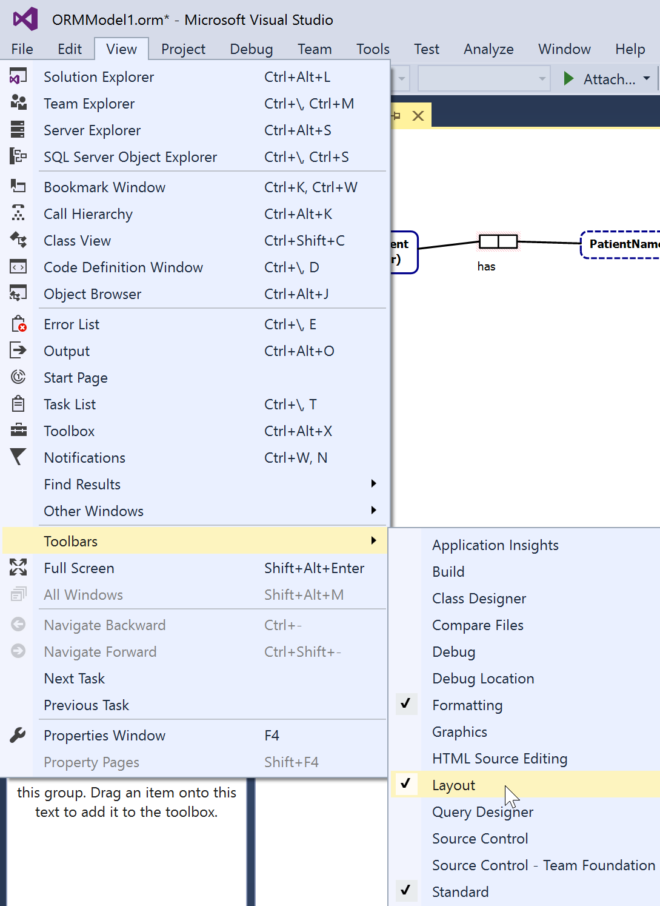
Display the Layout Toolbar
by selecting the menu option
View > Toolbars > Layout.
Ensure that at least the
following Toolbars
are displayed:
Formatting
Layout
Standard

Slide 14
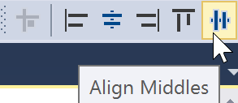
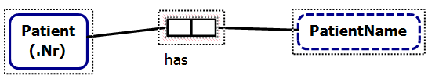

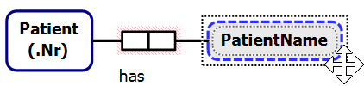
Drag the mouse to select
the predicate and object types,
then
align these shapes horizontally
by choosing Align Middles
from the Layout toolbar¹.
The alignment is based on
the last shape selected.
¹ As an alternative to using the Layout toolbar,
you may select the menu options Format > Align > Middles
Nudge Patient closer to the predicate
by selecting Patient and
pressing the right-arrow key.
Similarly, nudge PatientName closer
using the left-arrow key.
Notes:
Alignment is activated if multiple top-level items are selected AND one of the top level items is the primary selection (indicated by a dotted line inside and outside the shape border). If a non-top level shape is the primary selection then alignment is not activated. You can shift-click on a selected element to make it primary, or Control-Click twice to turn selection off and back on for the element. Note that selecting the fact type (as opposed to one of its roles or internal uniqueness constraints) is tricky. Make sure the move cursor (4 arrow tips) is showing when you click the fact type to select it.

Slide 15
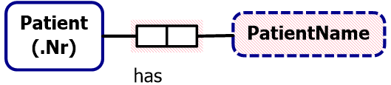
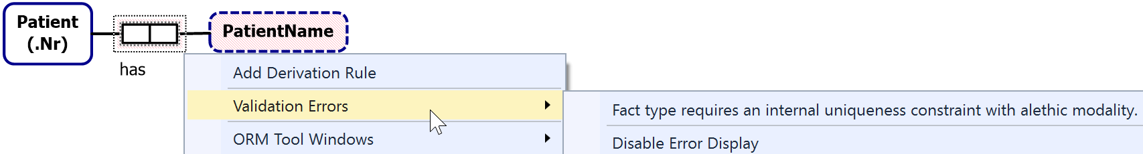
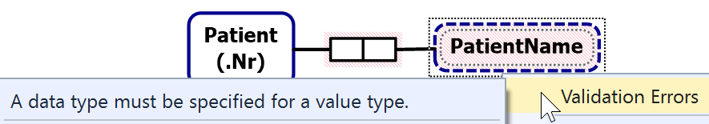
The predicate and object type are displayed with
a red line fill or outline, indicating an error state.
Here, the error on the predicate is that it has no uniqueness constraint.
To view errors on an element, right-click the element’s Context-menu
and select Validation Errors,
e.g. for the predicate we get
and for the PatientName value type we get
We will add the required constraint and data type later,
and at that point the red error fill will disappear.
Notes:
You can also double-click any shape (see notes in previous slide on where to click a fact) to activate the first error that supports activation. Error activation puts the editor in the state required to fix the error. In this case a double-click on the fact type (or selecting the error) will add an internal uniqueness constraint with no selected roles and activate it for editing. A second double click on the first role will add that role to the constraint and commit the change.
To be less invasive, the error fill color is actually pink rather than red, but think of it as red to associate it with the color commonly used for warning signs.

Slide 16
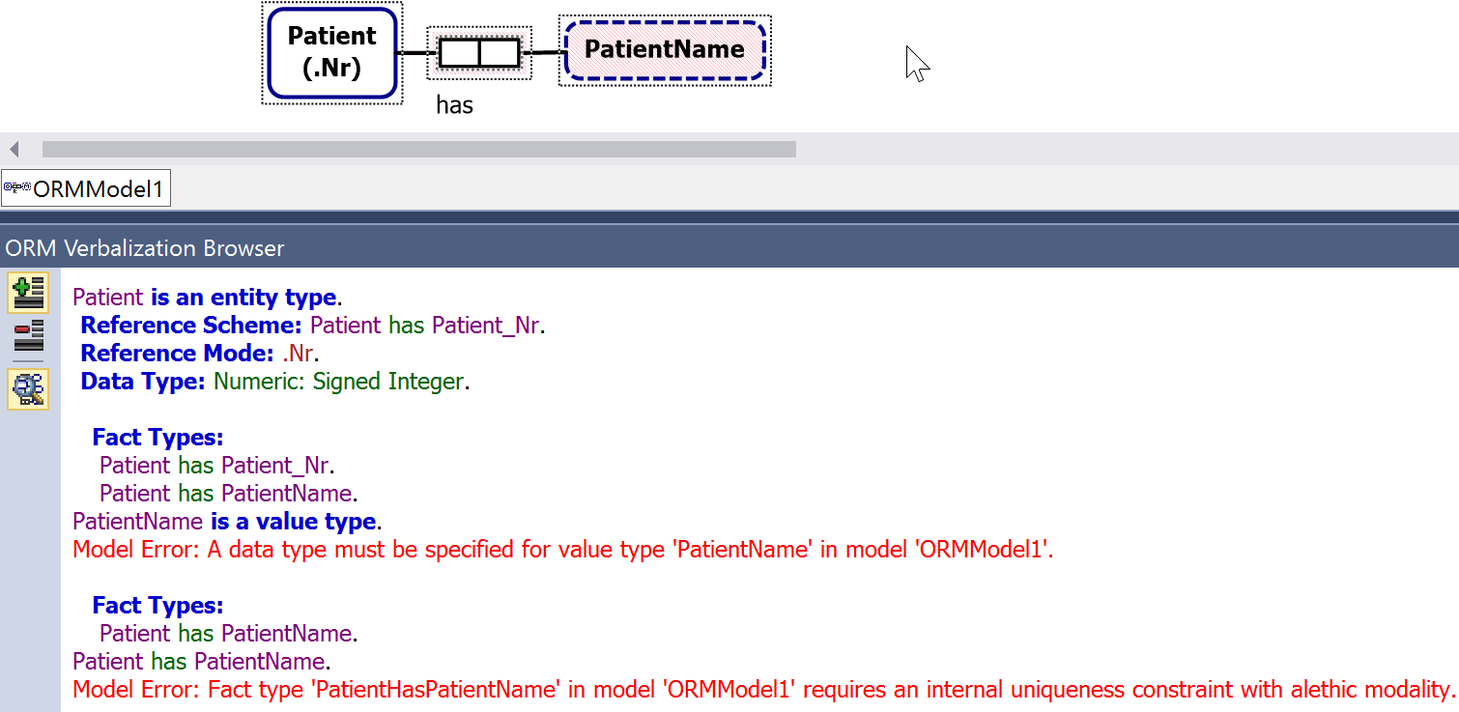
Alternatively, to view all the errors on the fact type,
select the whole fact type (not just the predicate)
and open the Verbalization Browser.
The model errors are displayed in red.

Slide 17
The document window has two scroll bars.
Use the bottom scroll bar to scroll horizontally.
Use the side scroll bar to scroll vertically.
To reposition any part of the diagram, select it,
then either drag it
or use the arrow keys to nudge it.
To select all of the diagram, press Ctrl+A.
To zoom in (magnify), press Ctrl+WheelUp -- wheel mouse
or press Ctrl+Shift+LeftClick.
To zoom out, press press Ctrl+WheelDown --wheel mouse
or press Ctrl+Shift+RightClick.
Notes:
You can see two parts of one diagram at the same time with the Window > New Window command. You can also add additional diagrams to the document.

Slide 18

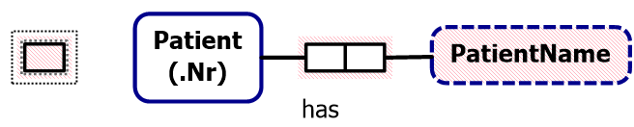
The full ORM schema includes two other fact types:
Patient smokes.
Patient is allergic to Drug(.Name).
You could enter these fact types in the Fact Editor.
Pressing Ctrl-Enter at the end of a line displays the fact type on that line.
This is typically the fastest way to enter fact types.
But instead, let’s enter the other two fact types graphically.
To add a unary predicate shape to the left of the Patient shape
either
Click the Unary Fact Type shape in the Toolbox
then click where you want the shape to display.
or
Drag a Unary Fact Type shape from the toolbox
to where you want it.

Slide 19
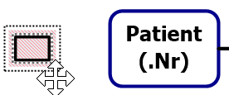

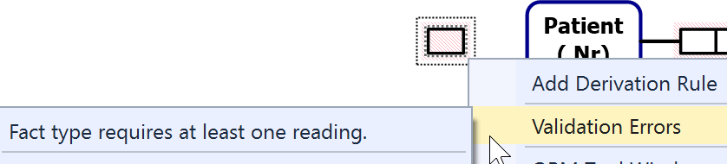

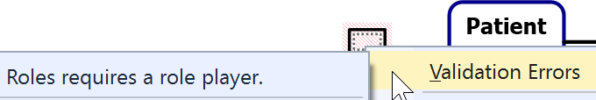
Select the unary fact type
(click just above its right top corner).
The Move Cursor appears to show the predicate is selected
(not the role).
Now right-click to see the validation error for the predicate.
Now select the role
(click inside it)
then right-click to see the validation error for the role.

Slide 20
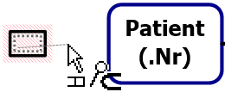
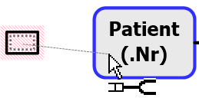
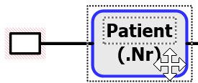
To connect the role to the Patient shape
select the role,
then drag the mouse pointer
(which now displays as a role connector pointer)
onto the Patient shape
then release the mouse.
Alternatively,
click the Role Connector shape in the Toolbox
then click the role and the Patient shape.
For practice, use Undo (select from the menu, or type Ctrl+Z)
to remove the connection,
then use the alternative method to restore the connection.
Notes:
You can also select the role and use the Properties Window to set the RolePlayer property.

Slide 21
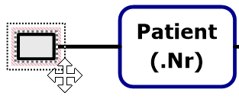
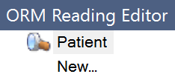

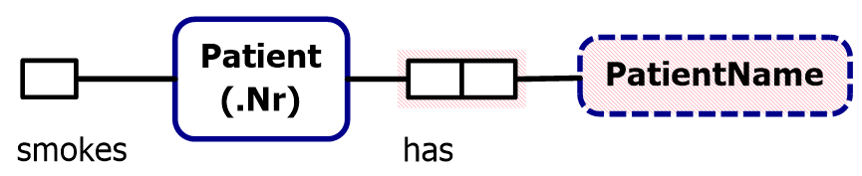
To add a predicate reading,
select the unary predicate shape
(not the role)
and double-click it to open
the ORM Reading Editor.
To reposition a predicate reading in the document window
select it then drag it to where you want.
Use Align Middles to align the shapes horizontally.
To change a predicate reading, select the reading on the predicate shape,
then select the reading in the Reading Editor, then edit as needed.
Type “smokes” after Patient
and press the Enter key.
The predicate reading should
now appear next to the role.
Notes:
Activating the error will make the correct selection in the ORM Reading Editor and activate the control for editing.

Slide 22
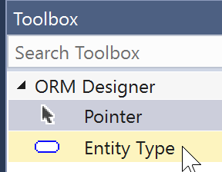
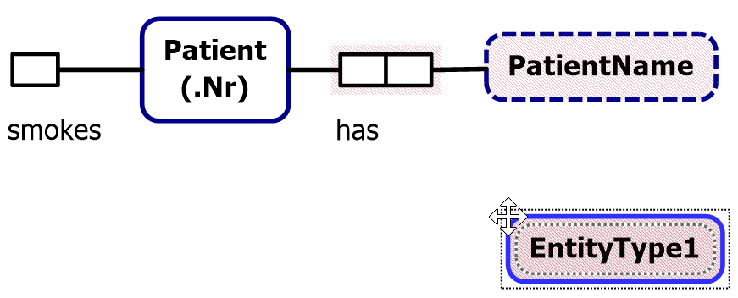
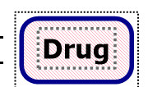
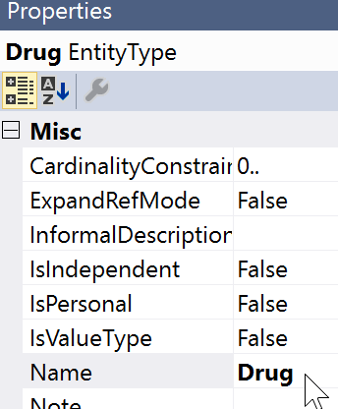
To add the Drug entity type,
drag the Entity Type shape from the Toolbox to the document window.
It initially displays with a default name, e.g. “EntityType1”.
Change the name to “Drug”,
either by editing it in place
or by editing the Name entry
in the Properties window.
Notes:
F2 can be used to activate any in-place editing.

Slide 23
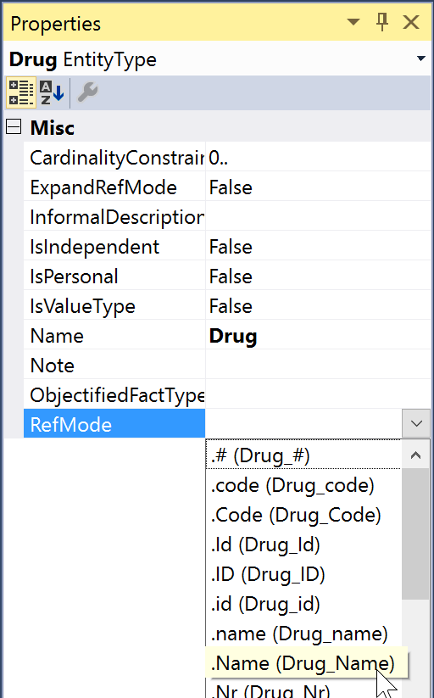
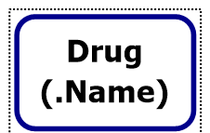
Add the reference mode “Name”
in the RefMode property
either by typing it and hitting Enter
or
by selecting it from the drop-down list
of pre-defined reference modes.
The reference mode is now displayed
on the diagram.
Notes:
Double-click the Drug entity type to automatically open the RefMode dropdown.

Slide 24
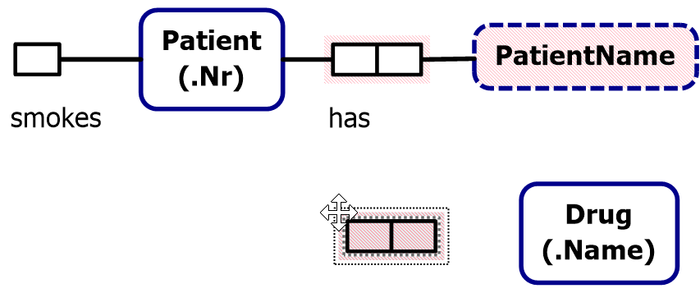
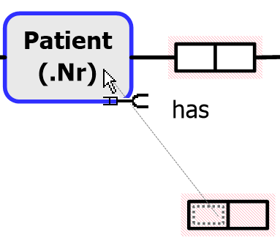
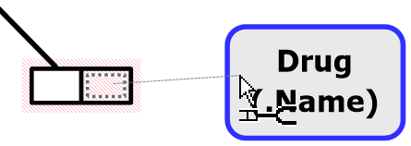

Click the Binary Fact Type shape in the Toolbox
then click where you want to position it
(alternatively,
drag the shape from the Toolbox)
To connect the left role, select it
(click the mouse pointer inside it),
then drag the mouse pointer
to the Patient shape.
Similarly,
select the right role
and drag the pointer to connect it.

Slide 25

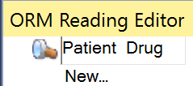
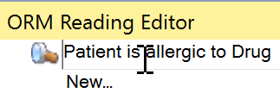
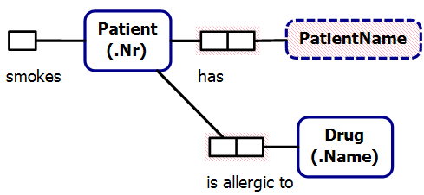
To add a reading for the new predicate,
first select it (click its border so that
the mouse pointer displays as )
Double-click the predicate,
to invoke the ORM Reading Editor
then enter forward predicate reading
“is allergic to” between
“Patient” and “Drug”.
The reading now displays
on the diagram.
Notes:
The ORM Reading Editor is available with any selection that is associated with a fact type (role, reading, constraint, rolename, fact type, etc).

Slide 26
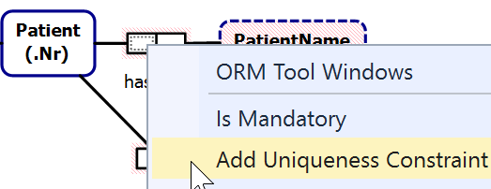


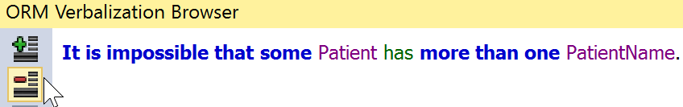
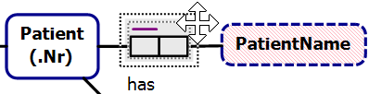
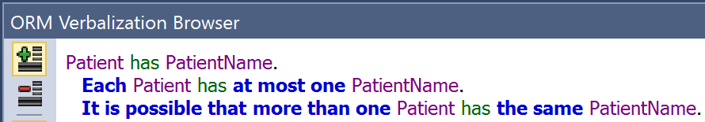
Select the left role
of the patient name fact type,
right-click to open its context menu
and click Add Uniqueness Constraint.
The constraint is now displayed.
Select the constraint, and click the
ORM Verbalization Browser
to see the positive verbalization.
Click the button
to see the negative verbalization.
Select the whole predicate
to verbalize the fact type
and its constraint pattern
(uniqueness constraint
on first role only).

Slide 27
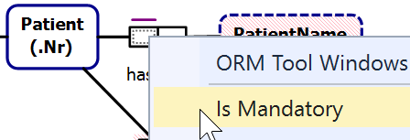
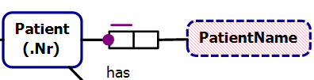
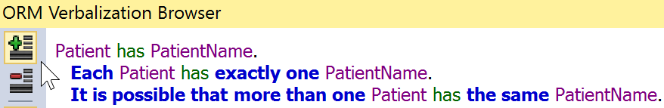
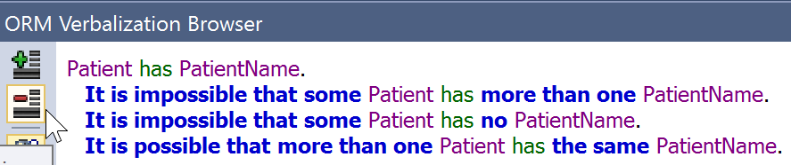
Select the left role
of the name fact type,
right-click to open its context menu
and click Is Mandatory.
The mandatory role constraint
is now displayed
and its verbalization is added.
Click for the
positive verbalization.
Click for the
negative verbalization.
Notes:
The IsMandatory property is also available in the Properties Window. In addition, for binary facts, the Multiplicity property on a role can be used to add uniqueness and mandatory constraints.

Slide 28
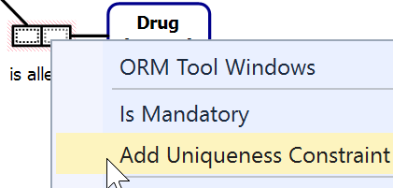


Select one role of the drug fact type then hold the Shift key down and select the other role, right-click to open its context menu
and click Add Uniqueness Constraint.
The constraint is now displayed.
In the Verbalization Browser, view
the positive and negative verbalizations.
Notes:
The toolbox gesture for this is:
Select Internal Uniqueness Constraint
Click the fact to add it to. The constraint will be added activated with no constraints.
Click the first role
Double click the second role to add it and commit the constraint
To extend a single role constraint:
Double-click the constraint to activate it for editing
Double-click the role to add
To make a double-role constraint a single
Double-click the constraint to activate it for editing
Control-Double-Click the role to remove

Slide 29




By default, NORMA places the mandatory role dot
at the role end
instead of at the object type.
This helps to disambiguate the constraint
when role attachments are very close together
e.g.
this diagram is ambiguous
but this is unambiguous.

Slide 30


To change this default (as well as many other options)
open the Options Window (main menu: Tools > Options…)
then select ORM Designer,
and scroll to Mandatory Dot Placement.

Slide 31



Double-click the field entry for Mandatory Dot Placement
to toggle its value (from RoleBoxEnd to ObjectShapeEnd).
Alternatively, choose the desired
option from the drop-down list.
To activate this choice,
press OK
(this remains your default
preference until you change it).
The mandatory role dot is now
displayed at the object type end.
Notes:
Note that these are machine-specific settings. All diagrams display according to the users settings.

Slide 32




By default, NORMA sets data types
to Unspecified
until you assign a specific data type.
As ORM schemas often include many value types
that are based on string data types,
you can save yourself some work by setting the
default data type to TextVariableLength.
To do this, use the Tools > Options dialog to
set the Initial (default) Data Type
to TextVariableLength
then press OK.

Slide 33





Setting the default data type
has no impact on the three object types,
since you created them earlier.
To set the data type for PatientName,
select the PatientName shape,
then in its Properties grid
select the DataType property
and choose
Text: Variable Length
from the drop-down list.
Then enter 30 in the
DataTypeLength property.
This sets the data type
to varchar(30).
The red error fill disappears,
since the data type is set.

Slide 34



If you earlier selected the “.Nr” RefMode
for Patient from the drop-down list,
its data type is set to Signed Integer.
Select Patient and change its
data type property to
Numeric: Unsigned Integer.
If you earlier selected the “.Name” RefMode
for Drug from the drop-down list,
its data type is already set to variable length text.
If not, select Drug and change its data type to that now.
Regardless,
you still need to
set the data type length
(e.g. to 20).

Slide 35



Let’s add the role name “allergy”
to the role hosted here by Drug.
To do this, select the role
and then add the role name
“allergy” in the Name property
in the Properties window.
The role name is displayed
in square brackets
on the diagram.
Select then drag the role name
to your preferred position
near the role box.

Slide 36




If desired, select the smokes role,
and add the role name isSmoker.
This is purely to predetermine
a better choice of attribute name
for the relational schema
and code generation.
If you wish, you may toggle
display of role names on/off
using the Tools > Options dialog.
Notes:
Each fact type shape also has a DisplayRoleNames property that can be used to control role name display on individual fact types.

Slide 37

Let’s now reposition the uniqueness constraint bar on the
“Patient is allergic to Drug” fact type below the predicate shape.
Right click the predicate, then choose
Orientation > Constraints on Bottom.
If you wish, nudge and
realign the shapes to
give a neater layout.

Slide 38



The allergy fact type is m:n
(i.e. many-to-many)
so will map to a table by itself
when we generate a relational schema.
The table name will be the name of
the fact type, which by default
is the fact type’s primary reading
“PatientIsAllergicToDrug”.
Select the fact type, and look at its
name in the Properties window.
Edit the Name property
to “DrugAllergy”.
This will now be used as the
generated table name.

Slide 39

Make any fine adjustments
you like to the figure
and then save the file
either
by pressing the Save icon
on the main menu
or by choosing the relevant Save option
from the File menu.
If desired, choose SaveAs to save another copy of the model
(entering your desired filename and folder destination).
You may also choose Save All to save all the open files.

Slide 40


For practice, Exit Visual Studio by clicking the Close icon.
Now open Visual Studio again, and reopen your saved file
by choosing File > Recent Files
and selecting the file you wish to work with.

Slide 41
NORMA supports mappings to/from various implementation artifacts

Slide 42
Generating a Relational View

Slide 43



To generate a relational view
right-click in the document window
and choose Extension Manager …
In the Extension Manager
dialog, select the
“Relational View”
check box as shown
(this will automatically turn
on the “Map to Abstraction
Model” and “Map to
Relational Model”
check boxes)
and then press OK.
Note: The Multiple Page Relational View option is available only in the Professional version of NORMA

Slide 44



A Relational View tab now
appears next to the ORM Model
tab below the Document Window.
Select this tab to see the
relational diagram view.
Reorder the column display in the DrugAllergy table
to show the patientNr attribute at the top.
To do this, select the patientNr attribute and drag it to the top position.

Slide 45

Drag the Patient and/or DrugAllergy table shape(s)
to improve the layout, as shown.

Slide 46

The ORM Model Browser
now includes a Relational Schema
node.
Expand the tree by toggling the
“ ” expand buttons to see the
relational schema details, as shown.
Mandatory columns are displayed in bold.
The relational schema is implemented
as a view of the ORM schema, so changes
in the ORM schema are reflected in the
relational schema.
Changing names and mandatory role
settings in the ORM schema are reflected
immediately. Other changes currently cause
the tree to contract, so to see those
changes you need to re-expand the tree.
Now save your work.

Slide 47
Generating DDL code

Slide 48


To generate code from an ORM schema,
first create a new project using C# or Visual Basic¹.
Launch Visual Studio.
File > New > Project
Select Visual C# or VB,
and a template (e.g.
Windows Forms App,
Console App, or
Class Library).
Add project name.
Uncheck the Create
directory option.
Press OK.
  ¹ The type of project you create determines the type of generated 3GL code
  (assuming you are going to generate C# or VB code).

Slide 49


Right-click the Project name
in the Solution Explorer,
then choose
Add > Existing Item….
In the Add Existing Item dialog,
click to change to the Projects folder,
set “Files of type:” to
All Files (*.*) to include .orm files,
then select your ORM
File (Lab1.orm)
and press Add to add
a copy of your ORM file
to the project
If you later want to
Make changes to the
ORM File inside the
project, do it to that
copy.

Slide 50
As seen before, the ORM schema maps to
a 2 table relational schema
To generate the DDL code to create the relational schema,
proceed as follows.

Slide 51


To generate code from the ORM model,
first select the model file in Solution Explorer.
In the Properties window,
check that “ORMCustomTool”
is the value for the CustomTool property.
(This should be there by default)
The ORMGeneratorSettings property
should be visible in the dialog
(if not, click a different item in
Solution Explorer and
reselect your ORM file).
Now click the button at the right.

Slide 52


The ORM Generator
Selection dialog
now appears.
Now select
the target(s)
for code generation.
For this example,
let’s choose
SQL Server.
Press Save Changes.
After clicking Save Changes, the generation takes a little while.
When generation is complete, the dialog closes.

Slide 53


In Solution Explorer
press the expand button
for the ORM file
to view the files below it.
Now select the relevant code file
(e.g. Lab1.SQLServer.sql)
and view the code generated
(or right-click and choose Open
from its context menu).

Slide 54

To ensure that code is word-wrapped, set this option in Visual Studio.
Choose Tools > Options,
select Text Editor > All Languages – General, check the Word wrap
option, and press OK.

Slide 55

The code currently generated for SQL Server is shown below.

Slide 56
Generating other code

Slide 57

To see code
generation for
other targets,
repeat the procedure
for ORM Generator
Settings
(press button),
select desired options,
press Save Changes
and open the
relevant files to
see the code
generated.
*** Generation options may change between versions.***
Note: Check PlixSupport at most once per project.
For the options shown here, choose PLiX_Implementation
to generate C# code.
Notes:
As noted in the SourceForge install instructions, you’ll need the http://www.sourceforge.net/projects/PLiX files installed to see the CSharp and VisualBasic code generation.

Slide 58


To see the C# generated, select the ORM
file in Solution Explorer, expand the abstract
PLiX entry and double-click the .cs file under it.
A fragment of the code is shown below.

Slide 59
C# was generated because
we initially set up our project as a C# project.
If we had instead created a Visual Basic project,
then VB code would have been generated
(with code file suffix .vb).
In a VB project, ‘Show All Files’
needs to be selected in the Solution Explorer toolbar.
DO NOT delete generated files from Solution Explorer.
To remove generated files, open the ORM Generator Settings dialog from the properties window of the ORM file. Deselect the generator types that you do not want, and then click Save Changes. The unwanted generated files will then be removed.

Slide 60
That concludes laboratory session 1. Lab 2 introduces ternary associations, external constraints, value constraints, and derived fact types.

